Slide 1

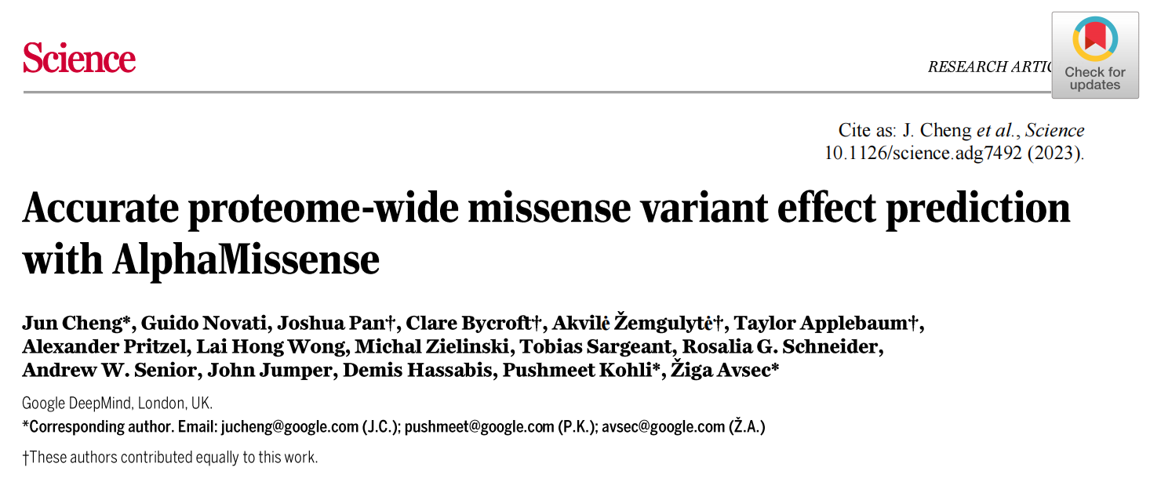
Authors: Fulong Yu，Liam D. Cato
From: Nature Biotechnology, June 2022
DOI: https://doi.org/10.1038/s41587-022-01341-y
Reporter: Huang Wenkui
Notes:
使用AlphaMisense准确预测蛋白质组的错义变异效应

Slide 2
Motivation
Background：
Missense variants are genetic variants that alter the amino acid sequence of proteins.
Lack of accurate missense variant functional predictions limits the diagnostic rate of rare diseases, as well as the development or application of clinical treatments.
Challenges for pathogenicity prediction of missense variants：
The majority of missense variants are of unknown clinical significance:
Of the more than 4 million observed missense variants, only an estimated 2% have been clinically classified as pathogenic or benign.
multiplexed assays of variant effect (MAVEs) experiments required lots of cost and labor:
Although MAVEs systematically measure protein variant effects and can accurately predict the clinical outcomes of variants, a proteome-wide survey of variant pathogenicity remains incomplete because of the cost and labor required for MAVE experiments.

Slide 3
Motivation
Machine learning methods follow four broad strategies：
1: train directly on human-curated variant databases.
Such strategies will inherit biases from the human curators and previous in silico predictors,
and they are prone to leaking data between training and test splits.
2: train with weak labels that do not depend on human classification.
In the training data, "benign" variants are defined as variants frequently observed in human or other primate species.
The "pathogenic" class is approximated with hypothetical variants unobserved in the human population.
However, the training data contain many false labels.
3: use unsupervised approaches to model the distribution of amino acids at a given sequence position conditioned on an amino acid sequence context.
In such models, pathogenicity is interpreted as the difference in predicted log-likelihood between reference and alternate sequences. However, they lack the understanding of protein structure.
4: exploit protein structure to reason about pathogenicity.
Most of the protein structure was previously unknown, but it can now be predicted by using AlphaFold（AF）.
Notes:
蛋白质与人类的语言有天然的相似性。语言的字母可以对应到蛋白质的氨基酸序列，语言的字母组成单词可以对应到氨基酸构成二级结构，语言中单词组成有意义的句子可以对应到二级结构组成蛋白质的三级结构，有意义的句子组成复杂的文本可以对应到多个蛋白组成四级结构。

Slide 4
Motivation
AlphaMissense combines the following elements of existing strategies:
training on weak labels from population frequency data，avoiding circularity by not using human annotations;
incorporating an unsupervised protein language modeling task to learn amino acid distributions conditioned on sequence context;
incorporating structural context by using an AF-derived system.

Slide 5
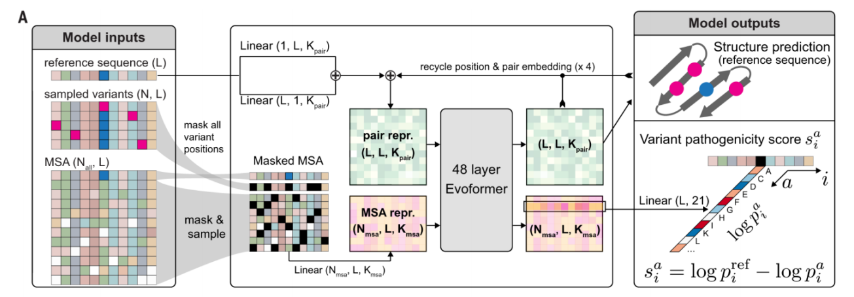
Overview of AlphaMissense

Slide 6
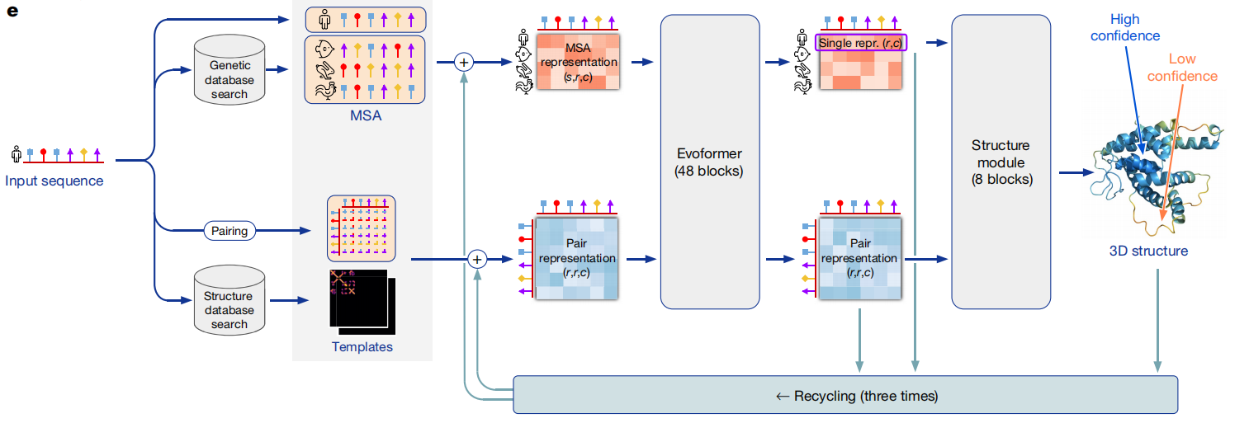
Overview of AlphaFold

Slide 7
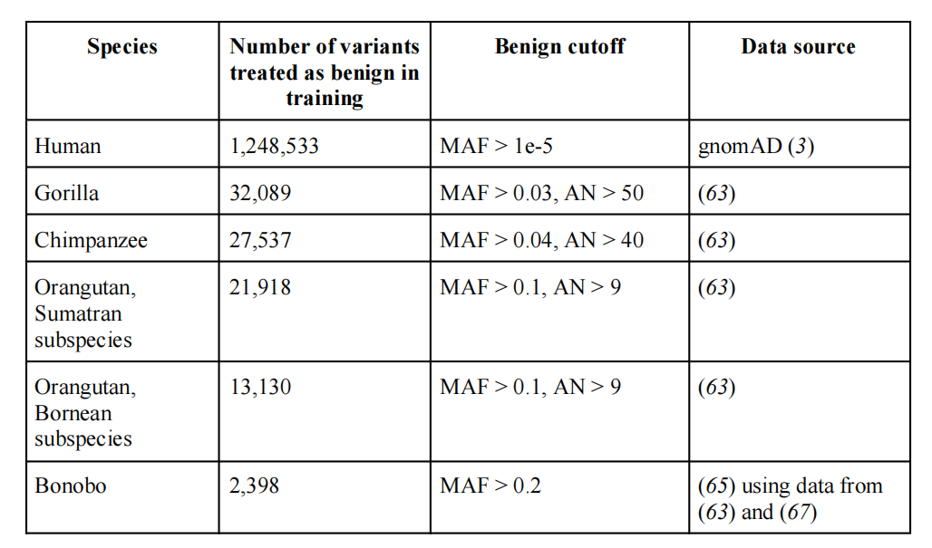
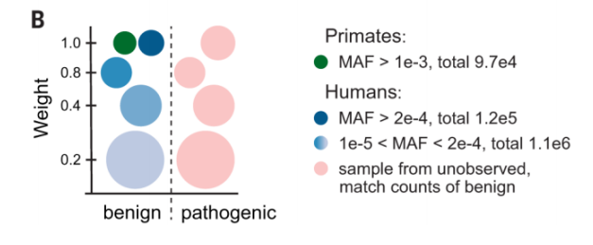
Methods
Training variants ：
Benign variants (negative class) in the training set were derived from observed variants in human and primate species.
The pathogenic labels for the training set are sampled from the remaining 65,314,044 variants that were not observed in any primate or human population.
The minor allele frequency as (MAF) is defined as min(AF, 1-AF) from the global allele frequency (AF). Benign variants were defined as those satisfying the allele frequency and the number of alleles (AN) requirements in at least one organism.

Slide 8
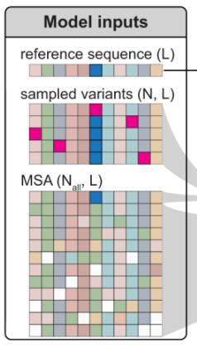
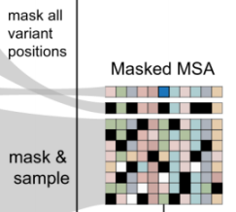
Methods
Spatial cropping：
use maximum sequence length (crop size) Nres=256 for both training and inference.
Protein sequences longer than 256 are cropped to keep 256 residual spatially closest to the sampled variant.
The spatial distance is defined as the minimum Euclidean distance between any atom of the residue and any atom of variant residue.
Variant MSA row and MSA masking：
the first row of the MSA corresponds to the wild-type sequence.
repeat this sequence in the second row of the MSA with N residues masked.
first sample a single variant (i.e. the central variant) and crop the sequence as described in the previous section.
During training, then query the training set for other variants for the same gene and within the cropped region.
The position of all N variants are masked in the second row of the MSA.
During training, all other rows of the MSA are masked and perturbed with the same probabilities.
During inference, only variant positions in the second MSA row are masked as described above

Slide 9
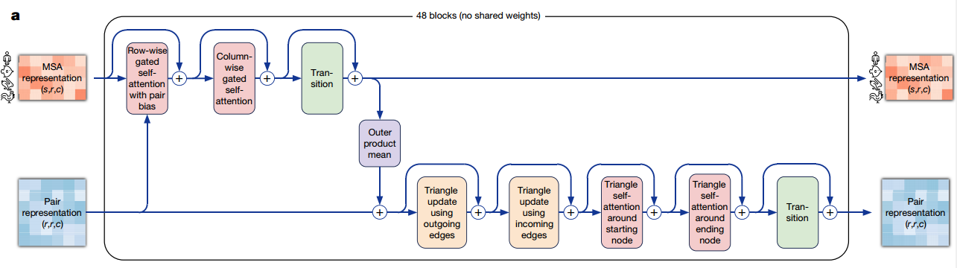
Methods
Featurization：
Similar to AlphaFold, input features are grouped as follow to the model:
aatype ：One-hot representation of the input amino acid sequence (20 amino acids + unknown).
residue_index：The index into the original amino acid sequence.
msa_profile：Average amino acid frequencies for all positions in the alignment.
Evoformer stack：
Evoformer block. Arrows show the information flow. The shape of the arrays is shown in parentheses
Notes:
原始的transformer输入是一个序列，但这里是一个矩阵，每一行是氨基酸序列，每一列是同一个氨基酸在不同蛋白质中的表现，所以得关注二维信息

Slide 10
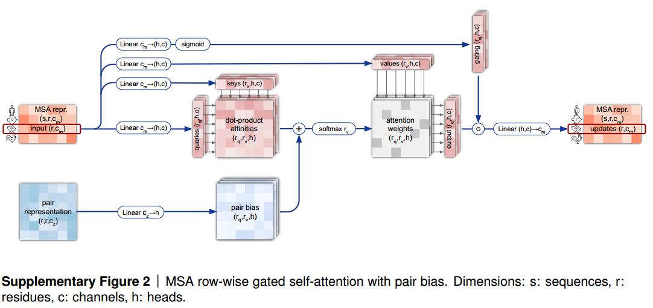
Methods
Notes:
按行的，带门的，有偏移的，注意力机制
门：先线性投影，再经过sigmoid函数使输出在0和1之间，在每个头都做一次计算，与下面的output作按元素点乘，就完成了门的操作，和LSTM一样用输出门控制输出，意思是如果值较大sigmoid之后为1，就是不改变原值放它出去，如果是不想放它出去的，就是0，这个作用就是控制哪些元素应该输出哪些不应该输出。
Q和k计算相似度的时候就是算第i个氨基酸和第k个氨基酸的关系，而这个pair矩阵也代表相似的信息，所以把它经过线性投影为1维后加入作为偏移。

Slide 11
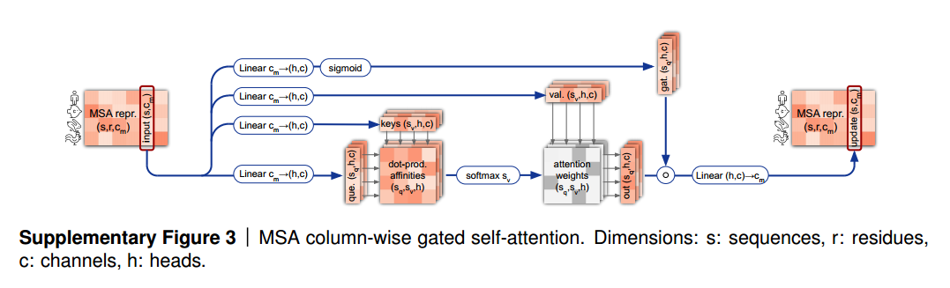
Methods

Slide 12
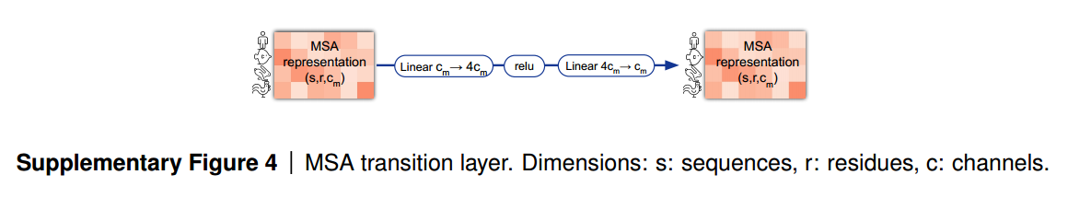
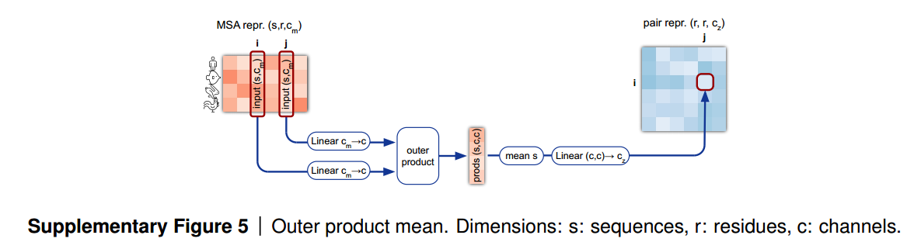
Methods
After row-wise and column-wise attention the MSA stack contains a 2-layer MLP as the transition layer.
The intermediate number of channels expands the original number of channels by a factor of 4.
Notes:
图5是紫色模块，将MSA氨基酸序列的表示信息融入氨基酸对的表示中，氨基酸i和j在msa里都是一个矩阵，具体来说氨基酸i在每一个蛋白质中都是一个长为cm的向量，这里一共有s个蛋白质，
那就是一个s*cm的矩阵，经过线性投影到s*c的矩阵，之后作外积（s*c*1 和s*1*c）得到一个s*c*c的张量，然后在s维度上取平均得到c，c矩阵，再作一次投影得到cz向量，把它加回氨基酸对表示中。

Slide 13
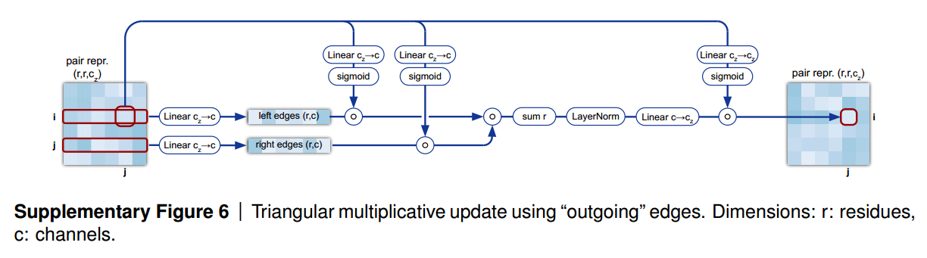
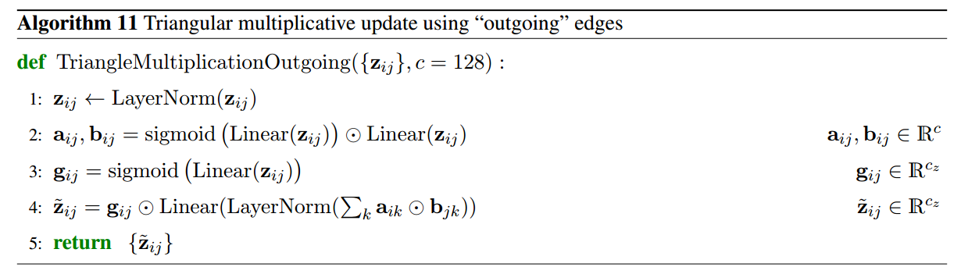
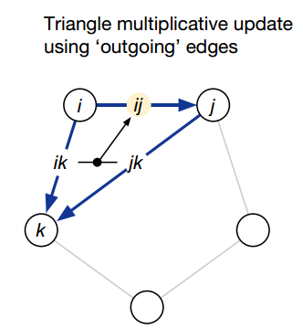
Methods
Notes:
输入门，控制哪一些元素需要，哪一些元素阻止
ij的信息由所有的ik和jk汇总而来
.Layerlorm是一种归一化层，用于对神经网络的输入或隐藏层О输出进行归一化操作。它的作用主要有以下几个方面:
1.标准化输入分布: nm.LayerKorm对每个样本在每个通道(channel)上进行标准化，使得每个通道的均值为0、标准差为1。这有助于将输入数据的分布规范化，减少不同样本之间的差异，有利于网络的稳定性和学习能力。
⒉缓解内部协娈量偏移∶在深度神经网络Q中，随着网络层数的增加，每一层的输入分布可能发生变化，导致网络难以训练。nn.LayerNorm可以在每一层内对输入进行归一化，减少层与层之间的协变量偏移，提升网络的训练效果。
3.提升模型泛化能力:通过归一化操作，n.LayerKorm可以减少不同样本之间的差异，提高模型对于输入的泛化能力。它有助于模型对于不同批次和样本的输入具有更好的适应性和鲁棒性。
4.减少模型复杂性:相比于其他归一化方法一，如批量归一化(Batch Normalization)，nn.Layerlorm是逐通道进行归一化的，不涉及批次维度，因此参数量较少，对于小批量或单样本的情况更加适用，减少了模型的复杂性和计算量。

Slide 14
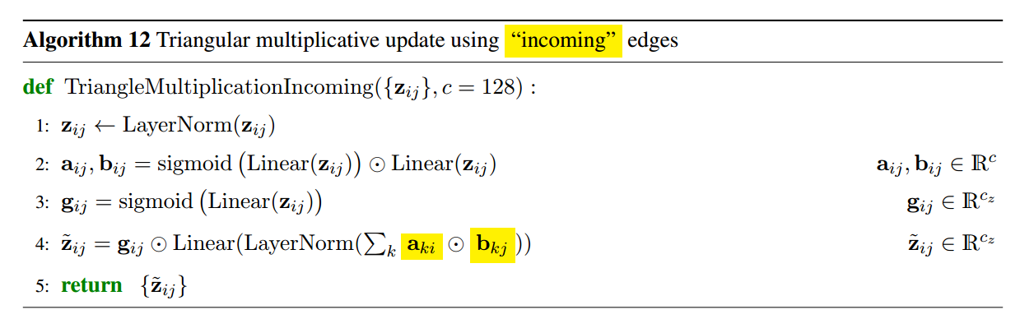
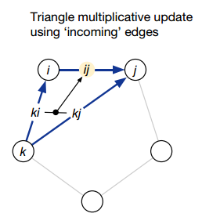
Methods
Notes:
对称性交换，既汇聚了出去边的信息，也汇聚了回来边的信息

Slide 15
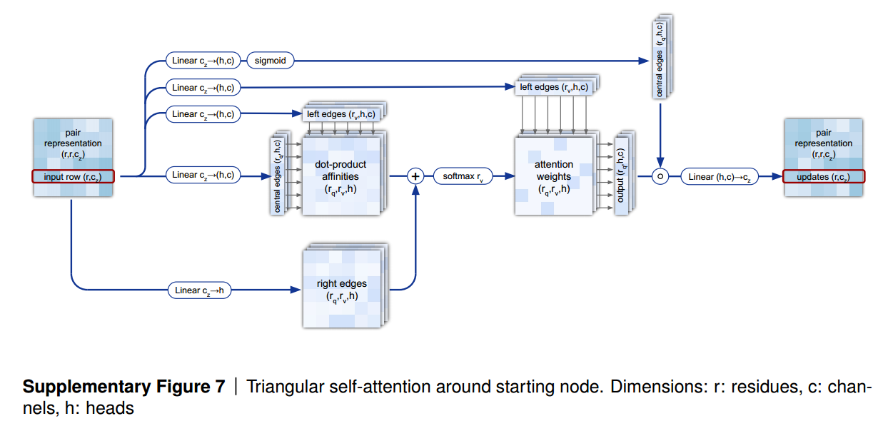
Methods

Slide 16
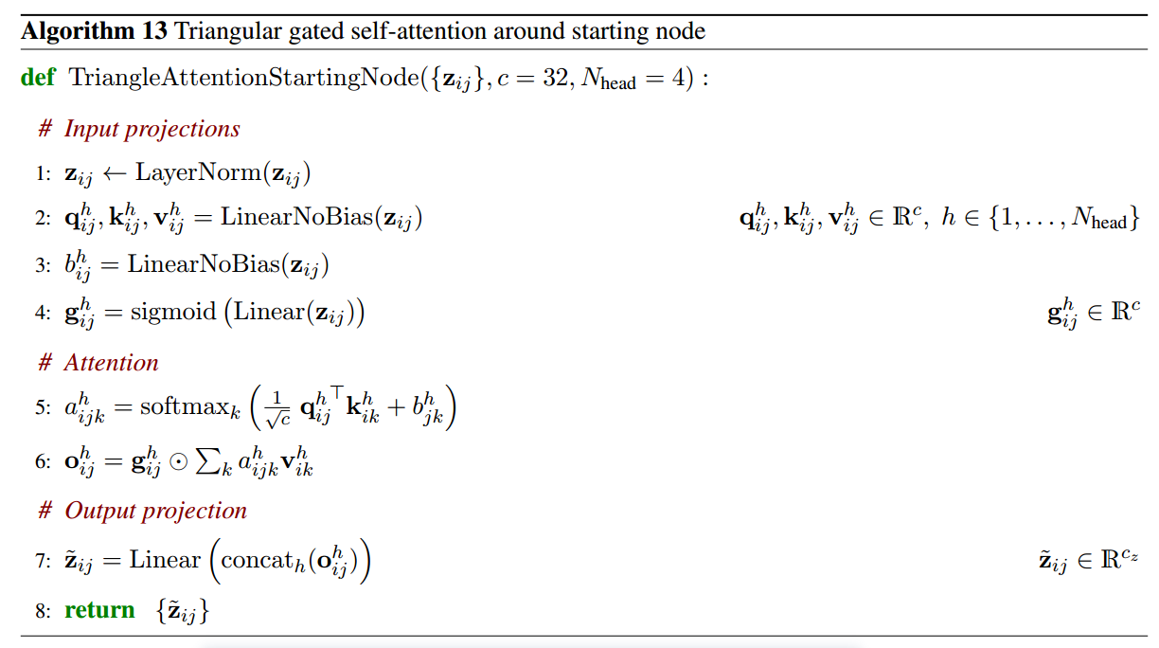
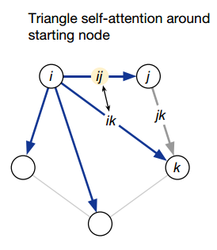
Methods

Slide 17
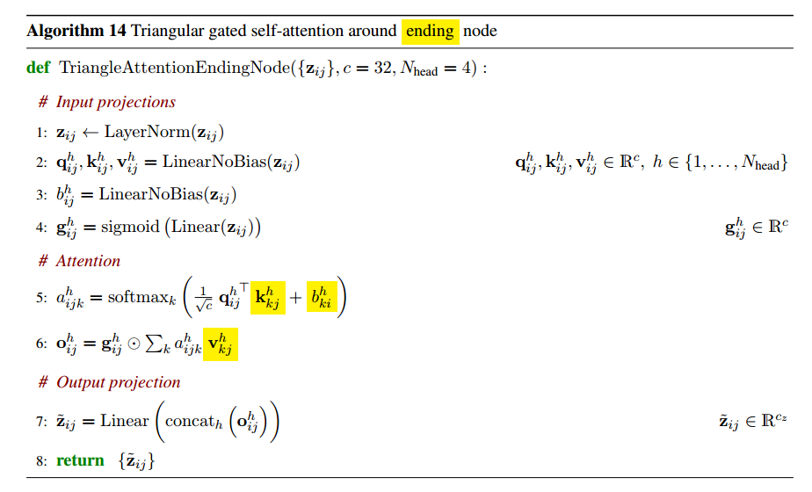
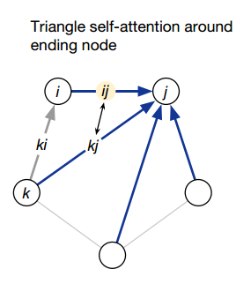
Methods

Slide 18
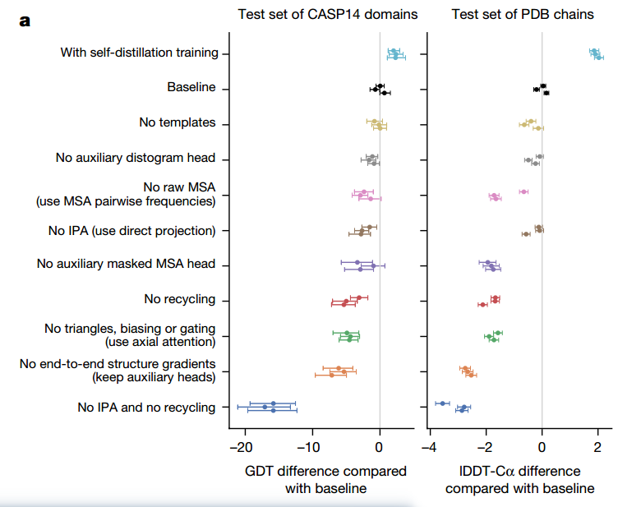
Results

Slide 19
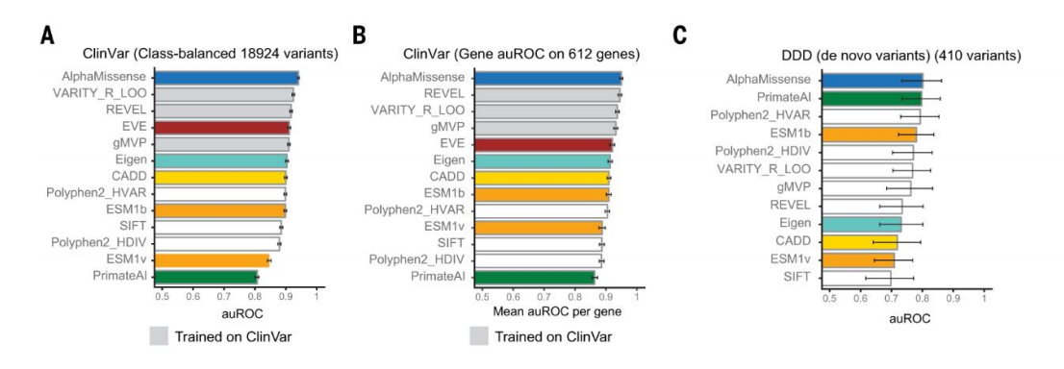
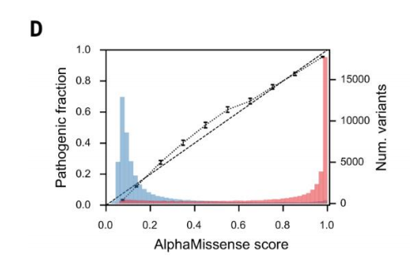
Results

Slide 20
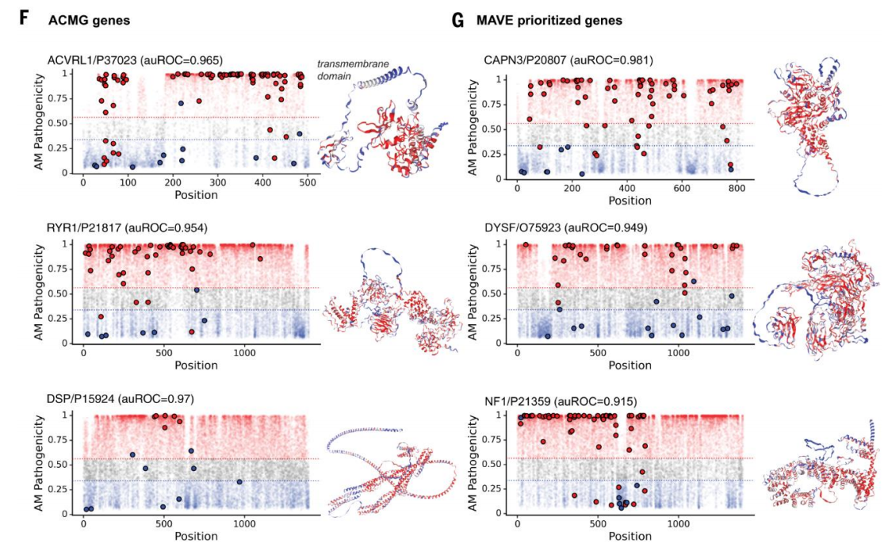
Results
Notes:
用于两种重要蛋白上突变的致病性预测，如右图所示，AlphaMissense 预测叠加在 AlphaFold 预测结构上的示例（红色=预测为致病性，蓝色=预测为良性，灰色=不确定）。
可视化结果揭示了蛋白质上一些关键位点突变更可能是有害的，例如ACVRL1的球状结构域（代表酶或蛋白质-蛋白质相互作用位点）上的突变比跨膜结构域上的突变更有害。

Slide 21
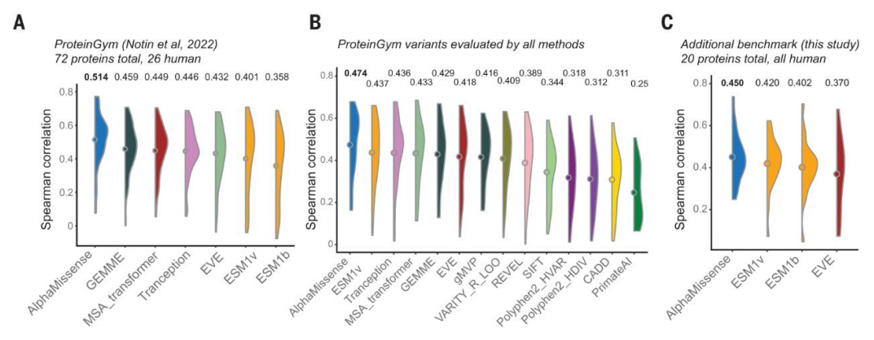
Results

Slide 22
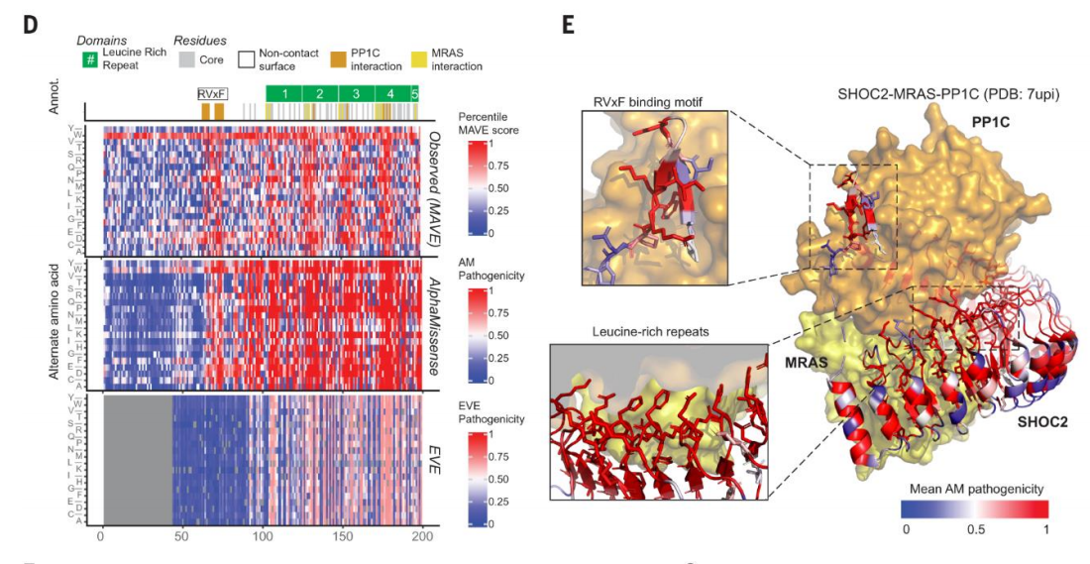
Results

Slide 23
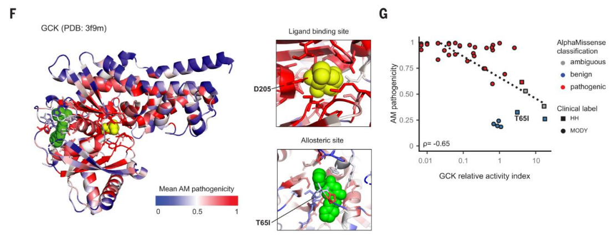
Results

Slide 24

Comment
2023“拉斯克基础医学奖”

Slide 25

Thank you for listening
Reporter: Huang Wenkui

